Slide 1

PROJECT REPORT
EAI-421: Application of AI & ML in Agriculture (0+10)
Project Title: Machine Learning in Biofertilizer Industry
Team:
BMB2034 Nisarga. P
BMB2053 Sweta K C
BMB2005 Akshatha Gopal

Slide 2
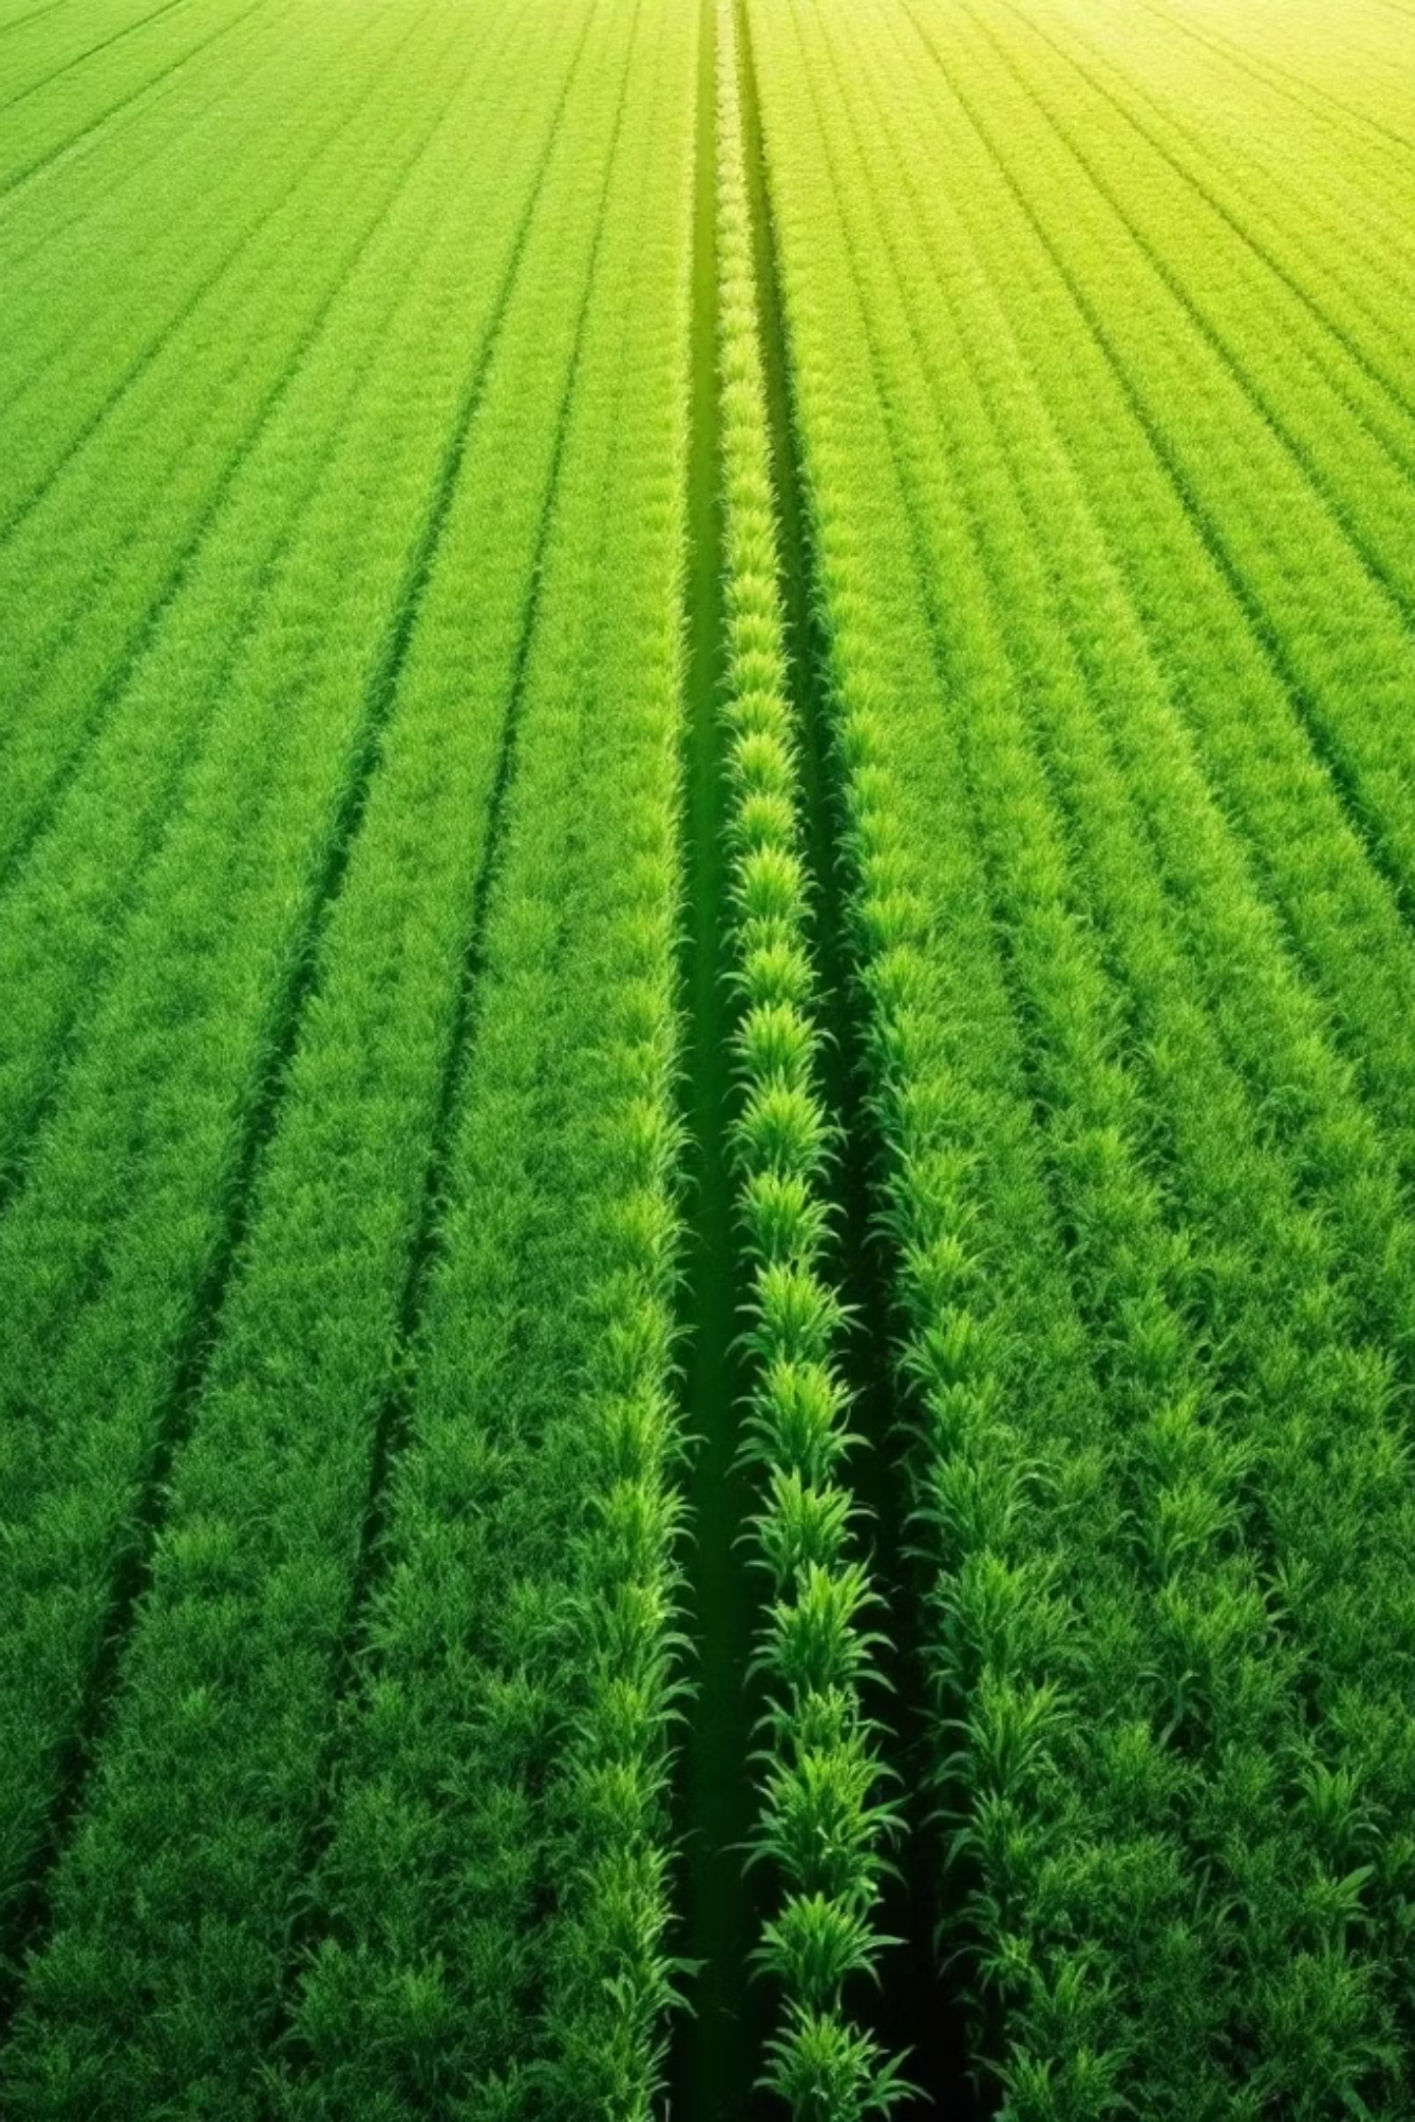
Machine Learning in
Biofertilizer Industry

Slide 3
SL.NO. | TOPICS | SLIDE NUMBERS
1. | Abstract & Problem Statement | 4
2 | Introduction & Background | 5
3 | Methodologies & Key Results | 6
4 | Review of Literature | 7
5 | Objectives | 8
6 | Materials & Methods | 9
7 | System Architecture | 10
8 | Experimental Results | 11 - 12
9 | Conclusion & Future Scope | 13

Slide 4

Abstract & Problem Statement
The Crisis
Global population projected to surpass 9 billion by 2050. Excessive synthetic fertilisers degrade soil — elevating acidity, reducing biodiversity, and emitting greenhouse gases.
The Solution
Biofertilisers (living microorganisms colonising the rhizosphere) offer a sustainable alternative — but optimal selection across diverse crops, soils, and climates demands ML-driven intelligence.
Scope
Implement and compare RF, SVM, k-NN, Decision Tree, and XGBoost for biofertiliser recommendation, evaluated on accuracy, RMSE, precision, recall, and F1-score.

Slide 5

Introduction & Background
Chemical Fertiliser Problem
Biofertiliser Types
Rhizobium, Azospirillum, Pseudomonas, Bacillus, PGPR, and fungal/algal biofertilisers improve nutrient bioavailability without ecological harm.
Excess N, P, K inputs reduce soil biodiversity, increase GHG emissions, and cause long-term fertility loss.
Why ML?
ML models nonlinear relationships between soil chemistry, climate variables, microbial dynamics, and crop outcomes — yielding actionable farmer recommendations.

Slide 6
Methodologies & Key Results
Five ML Algorithms
Results vs Existing Systems
XGBoost
Random Forest
Method
Application
Score
Gradient-boosted trees — 99.09% accuracy across 21 crops
Ensemble of 100 trees — +111% soybean yield with rhizobium
XGBoost
Crop recommendation
99.09%
Deep Collab. MF
Coffee biofertiliser
97.88%
SVM
PGPR prediction
F1: 0.95
SVM (RBF)
Decision Tree
Gradient Boosted
Drought-resilient strains
87%
Precision 0.97, Recall 0.91, F1 0.95 for PGPR prediction
Gini-based hierarchical classifier for feature-driven yield classification
Random Forest
Soybean + rhizobium
+111% yield
k-NN
Simple proximity classifier — poor on high-dimensional agricultural data

Slide 7
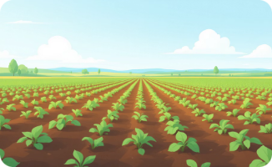




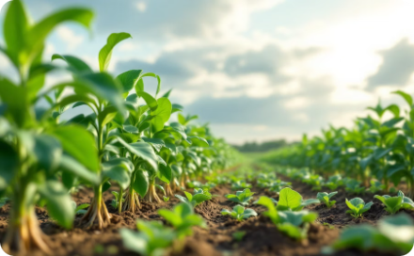

Review of Literature
Abbas et al. (2020)
Indumathi et al. (2021)
Raveena & Surendran (2023)
Miller et al. (2023)
SVR outperformed all models for potato yield prediction via proximal sensing. k-NN poor in 3 of 4 datasets. Large training sets essential.
SVM achieved precision 0.97, recall 0.91, F1 0.95 for PGPR identification in millet using NCBI genomic data — highest among all tested algorithms.
Gradient-boosted trees achieved 87% accuracy for drought-resilient microbial strain identification, requiring 3.38M computation time units.
Deep collaborative matrix factorisation achieved 97.88% accuracy for coffee biofertiliser recommendation, modelling plant health, weather, and soil interactions.
Dey, Ferdous & Ahmed (2024)
Jemo et al. (2023)
Show et al. (2023)
XGBoost achieved 99.09% precision across 21 crops using NPK, pH, temperature, humidity, and rainfall. k-NN least effective for high-dimensional data.
Random Forest revealed rhizobium + phosphorus increased average soybean yields by 111% across three agroecological zones in northern Nigeria.
Gradient boosting optimised digestate + chemical fertiliser for rice. Optimal CW-BF:NPK (3:1:1) produced maximum 7,521 kg/hectare grain output.

Slide 8
Objectives
1
2
3
CONSTRUCT Dataset
IMPLEMENT & COMPARE Models
ANALYSE & PROPOSE Framework
Build a multi-variable crop-biofertiliser dataset integrating soil parameters (N, P, K, pH, moisture), climatic variables, and biofertiliser labels from Kaggle, UCI, and NCBI — with preprocessing and feature engineering.
Train and evaluate RF, SVM, k-NN, Decision Tree, and XGBoost on the dataset. Measure accuracy, precision, recall, F1-score, and RMSE.
Identify the best-performing model, justify superiority through statistical analysis, and propose an integrated AI + IoT decision-support system for real-time biofertiliser recommendation.

Slide 9
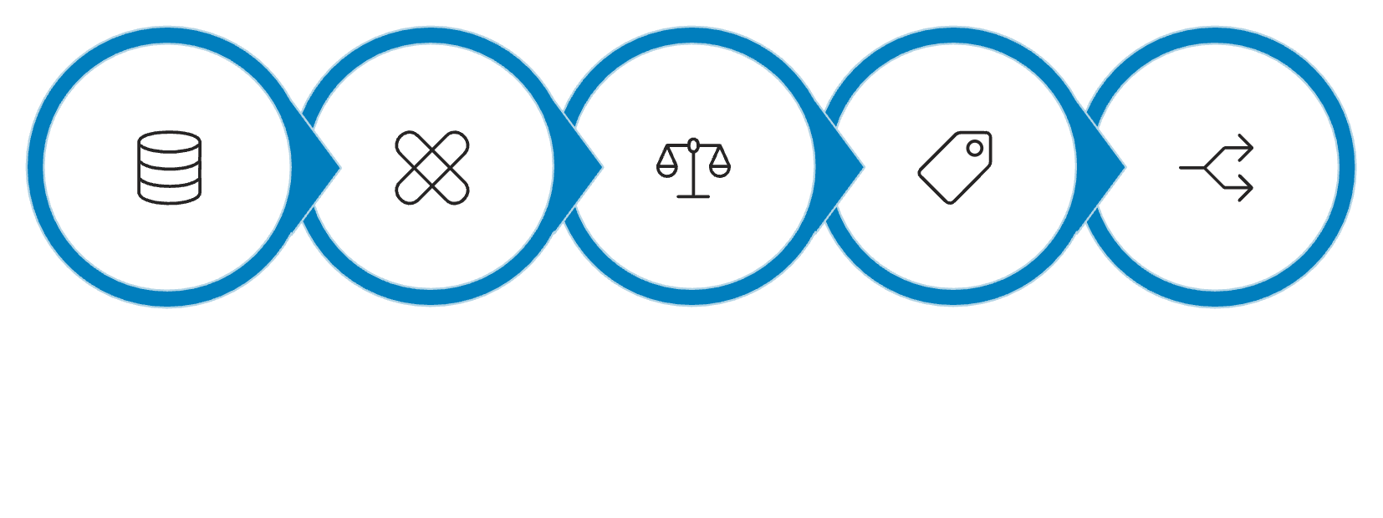




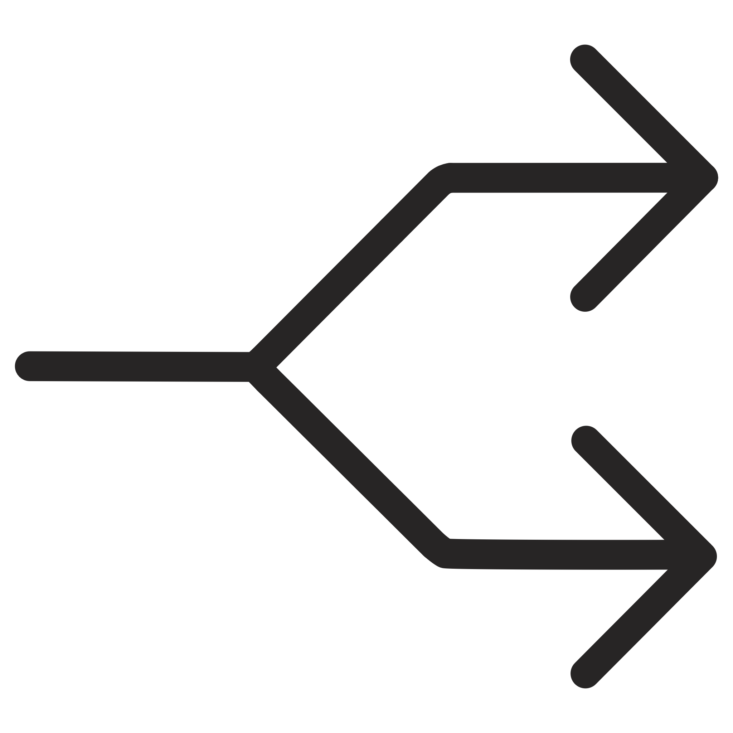
Materials & Methods
Dataset — Kaggle Crop Recommendation
2,200 records | 7 input features | 22 crop classes
Preprocessing Pipeline
Feature
Description
N, P, K
Soil macro-nutrients (kg/ha)
Temperature
Average temp (°C)
Humidity
Relative humidity (%)
pH
Soil pH (0–14)
Handle Missing
Feature Scaling
Train/Test Split
Rainfall
Annual rainfall (mm)
Load Data
Label Encode
Crop Label
Target class (22 categories)
Training set: 1,760 samples | Test set: 440 samples. Top-ranked features: N, K, humidity, and rainfall.

Slide 10
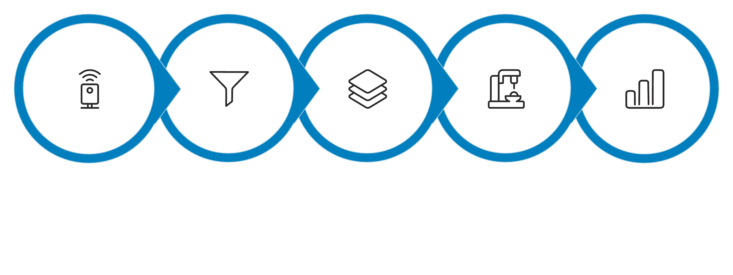





System Architecture
Input
Preprocess
Features
Train
Evaluate
The end-to-end pipeline ingests raw IoT sensor data, preprocesses and engineers features, trains five ML models in parallel, evaluates on 440 held-out samples, and delivers ranked crop + biofertiliser recommendations via web dashboard, mobile app, or IoT display.
Farmer Interface
ML System
Input soil data, request recommendations, view history, export reports
Preprocess → Train 5 models → Evaluate → Select XGBoost → Generate recommendation
IoT Integration
Admin / Researcher
Auto-collect real-time sensor data (pH, NPK, moisture, temperature, humidity)
Update dataset with field experiment data and retrain models

Slide 11
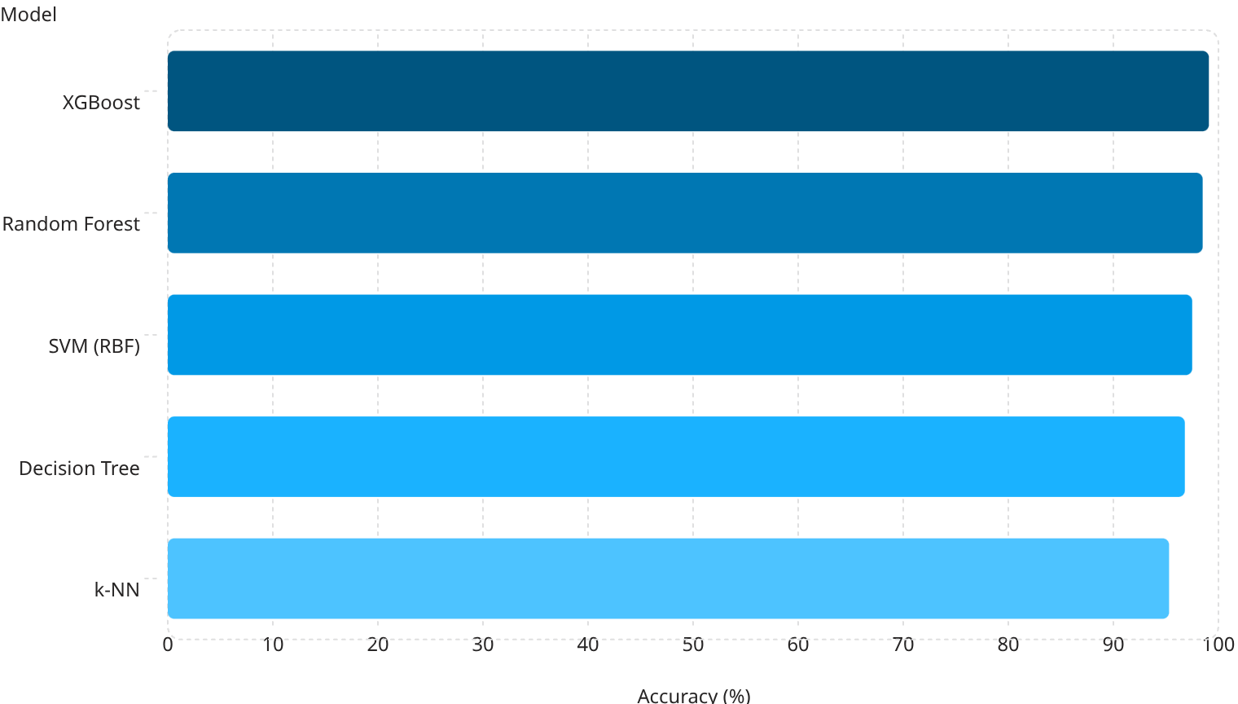
Experimental Results
99.1
98.5
97.5
96.8
95.3
Model Performance Summary
Model
Acc%
Prec
Rec
F1
XGBoost
99.09
0.99
0.99
0.99
Rnd Forest
98.50
0.99
0.98
0.98
SVM
97.50
0.98
0.97
0.97
Dec. Tree
96.80
0.97
0.97
0.97
k-NN
95.30
0.95
0.95
0.95

Slide 12
XGBoost Feature Importance
24.1%
19.8%
Humidity
Rainfall
Most influential — drives crop category boundaries
High importance for water-intensive crops (rice, jute)
18.7%
16.3%
Potassium (K)
Nitrogen (N)
Critical for differentiating fruit vs. cereal crops
Legume vs. non-legume biofertiliser selector

Slide 13


Conclusion & Future Scope
Future Directions
Conclusion
AI Integration
XGBoost's 99.09% accuracy surpasses
SVM (F1: 0.95), deep collaborative MF
(97.88%), and gradient-boosted trees
(87%). Humidity, rainfall, and potassium
are the most predictive features. ML
transforms biofertiliser recommendation
from heuristic guesswork into a scalable,
data-driven decision-support system for
sustainable precision agriculture.
CNNs for soil image analysis, LLMs for
regional-language farmer interfaces,
GANs for synthetic data augmentation
Federated Learning, and XAI
(SHAP/LIME) for explainability
IoT Integration
Smart soil sensor networks, automated biofertiliser dispensers, drone-based monitoring, edge computing (Raspberry Pi), and blockchain traceability
Research Extensions
Multi-season datasets, climate change adaptation (CMIP6), microbiome profiling (16S rRNA), and advanced ensemble stacking architectures

Slide 14


